Slide 1



Tasks List
Graduate Rotational Internship Program
The Sparks Foundation

Slide 2
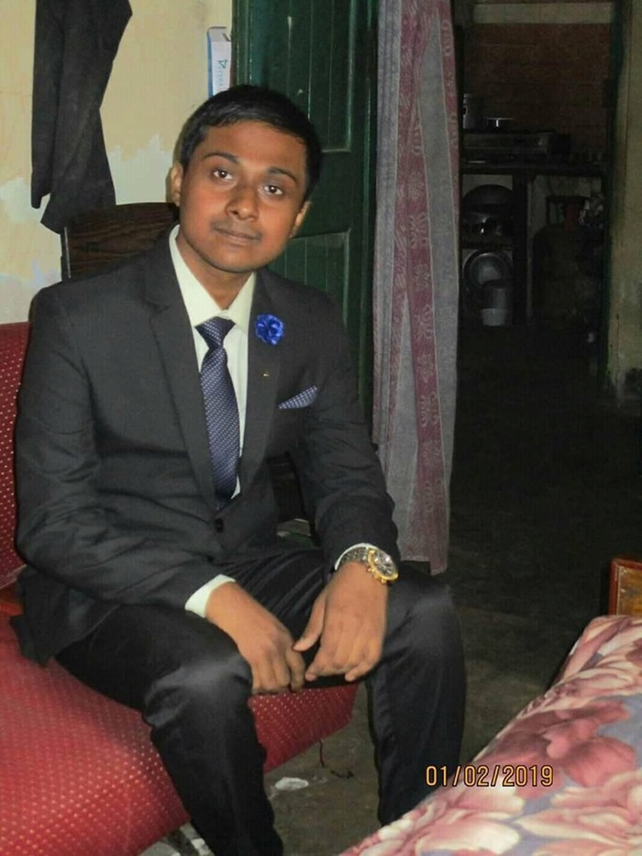
Name : Souvik Roy
Web Development
Intern
Batch : NOV2020
TASK 1(Technical)

Slide 3





Task List
The tasklist contains tasks in the following categories:
LinkedIn Profile Improvement (Mandatory for all)
Technology -
Web & Mobile Development, Data Science & Business Analytics Computer vision & IoT
Non-Tech -
Content Development & Digital Marketing, and Human Resources & Campus Ambassador

Slide 4




Basic Banking System
Create a simple dynamic website which has the following specs.
Start with creating a dummy data in database for upto 10 customers. Database options: Mysql, Mongo, Postgres, etc. Customers table will have basic fields such as name, email, current balance etc. Transfers table will record all transfers happened.
Flow: Home Page > View all Customers > Select and View one Customer > Transfer Money > Select customer to transfer to > View all Customers .
No Login Page. No User Creation. Only transfer of money between
multiple users.
Host the website at 000webhost, github.io, heroku app or any other free hosting provider. Check in code in gitlab.
#1

Slide 5
Details On my Project Name : MCB Bank
Name and logo have been chosen randomly.
Images are supposed to be copyright free even on cases otherwise, no copyright intended.
This project covers all that had been asked for and some additional add-ons as well.
Front end – HTML5, CSS, Bootstrap
Back end – PHP and JavaScript
Database used – MySQL
Server Facility – XAMPP (IP/localhost : 127.0.0.1)

Slide 6
How to use the github files?
First Extract the files in the zipped file (bankfiles.zip)
Create a folder bank where you need to clone every file provided one by one and keep the extracted folders into the same.
Once done you need host the website on a free server platform like XAMPP as in my case.
The localhost or connecting IP address will be : 127.0.0.1
The Preview of the website is provided in next page

Slide 7
YOUTUBE DEMO LINK
Sparks Fhttps://youtu.be/iSIJsArAqrMoundation Project.mp4

